Slide 1
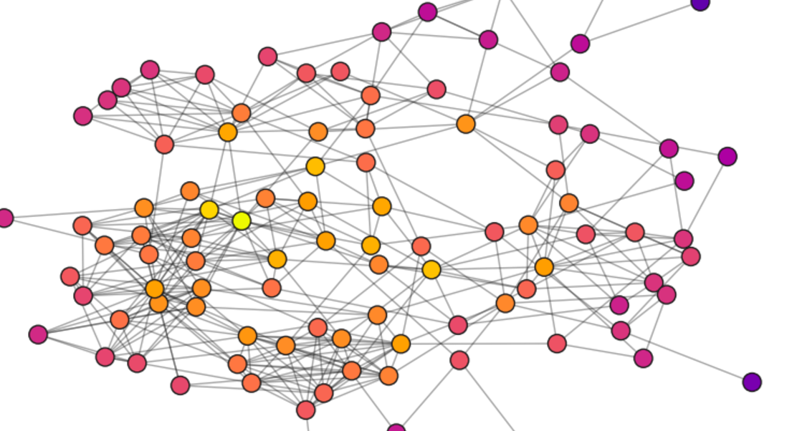
Supply Chain Network Analysis
using Graph Theory &
Community Detection
Graph-based insights for an FMCG Company
M Prathyusha Lahari
CB.SC.P2AIE24020

Slide 2
Problem Statement
Objective:
Identify communities within the supply chain.
Apply graph-based centrality measures to find key nodes.
Industry Focus:
FMCG Industry (Potato Chips Supply Chain)

Slide 3
Dataset Description
SupplyGraph: A Benchmark Dataset for Supply Chain Planning using GNNs
https://www.kaggle.com/datasets/azminetoushikwasi/supplygraph-supply-chain-planning-using-gnns/data
Has different Production Facilities, Products , Raw Materials
Each Production Facility can have Multiple Product groups like different types of chips.
A potato chip manufacturing company operates two facilities, producing four types of chips in various packaging sizes. The production process involves complex dependencies, such as shared raw materials, production capacity limits, and machine constraints, which affect efficiency.

Slide 4
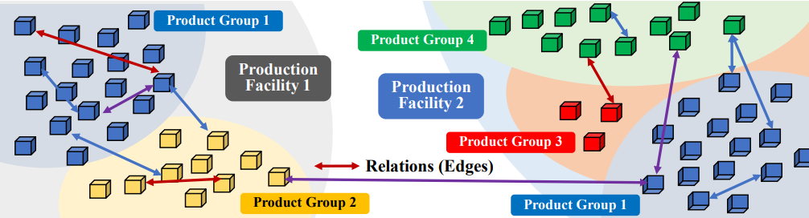
Sample Dataset Diagram

Slide 5
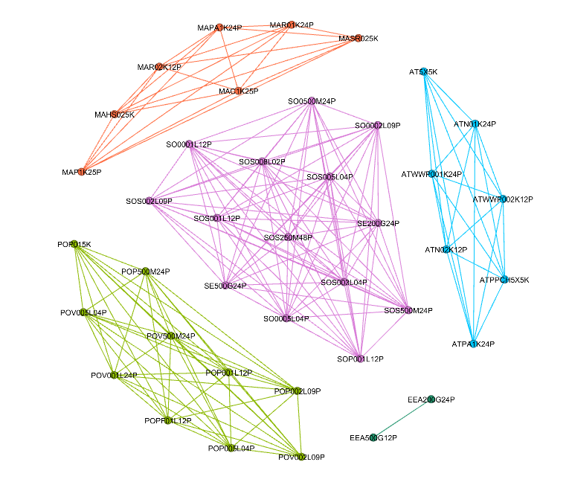
Product vs subproduct graph

